Slide 1




GENDER CLASSIFICATION FROM AUDIO SIGNALS USING GNNS
Advanced Machine Learning (06SM521-533)
Abu Bakr Rahman Shaik - 23-756-737 abubakrrahman.shaik@uzh.ch
Azizbek Asadov - 23-747-041 - azizbek.asadov@uzh.ch
Jaaylin Anthony Martin - 24-741-530 - jaaylinanthony.martin@uzh.ch

Slide 2


Agenda
01 | Problem Setting
04 | Related Work
05 | Methodology
06 | Analysis & Evaluation
07 | Conclusion

Slide 3
Problem Setting

Slide 4


Problem Setting
Gender classification real-world applications:
Security systems (e.g., voice authentication)
Healthcare (e.g., telemonitoring)
Human-computer interaction (personalized experiences)
Recent literature (Sensors 2024) showed GNNs excel in audio-based classification

Slide 5
Problem Setting
Gender classification real-world applications:
Security systems (e.g., voice authentication)
Healthcare (e.g., telemonitoring)
Human-computer interaction (personalized experiences)
Recent literature (Sensors 2024) showed GNNs excel in audio-based classification
Main Objective: Evaluate and compare 3 GNN and 3 PTMs architectures on this task

Slide 6
Related Work

Slide 7
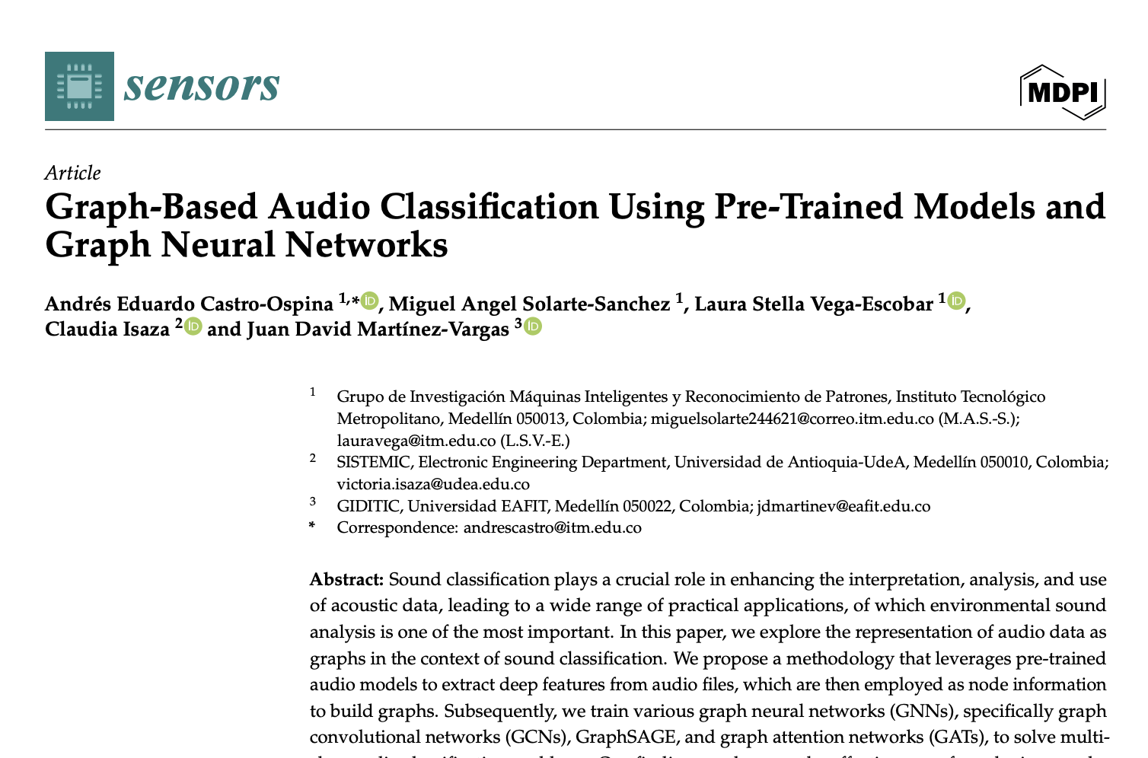
Related Work
Graph-Based Audio Classification Using Pre-Trained Models and Graph Neural Networks (Castro-Ospina et al. 2024)

Slide 8
Methodology

Slide 9
Methodology
We split our pipeline into 4 major stages:
1. Audio Feature Extraction using pre-trained models
2. Graph Construction based on extracted features
3. GNN Model Training (GCN, GAT and GraphSAGE)
4. Evaluation using standard classification metrics

Slide 10
Audio Feature Extraction
• PTMs: PANNs, VGGish, YAMNet
• Features extracted:
• Mel spectrogram
• Log-mel embeddings
• Tools: librosa, panns-inference, tensorflow_hub, pytorch libs

Slide 11
Graph Construction
Constructed graphs using k-Nearest Neighbors (kNN)
Nodes: audio samples
Edges: similarity (Euclidean distance between feature vectors)
Libraries: torch_geometric, sklearn

Slide 12
GNN Architectures Implemented
GCN (Graph Convolutional Network) - spectral-based aggregation of neighbor features.
GAT (Graph Attention Network) - attention-weighted neighbor feature aggregation.
GraphSAGE (Graph Sample and Aggregate) - designed for generating node embeddings, particularly for large graphs and inductive learning scenarios.
All models used:
Negative Log Likelihood Loss (NLLL).
Adam optimizer.
Dropout for regularization.

Slide 13
Datasets Used
Gender Recognition by Voice
16,000 raw audio samples.
Had to filter out unknown (None) labels.
10500 male and 5500 female labels.

Slide 14
Analysis & Evaluation

Slide 15
Analysis & Evaluation
Primary Metric: Accuracy
Additional Metrics:
Precision
Recall
F1-Score
Training time

Slide 16
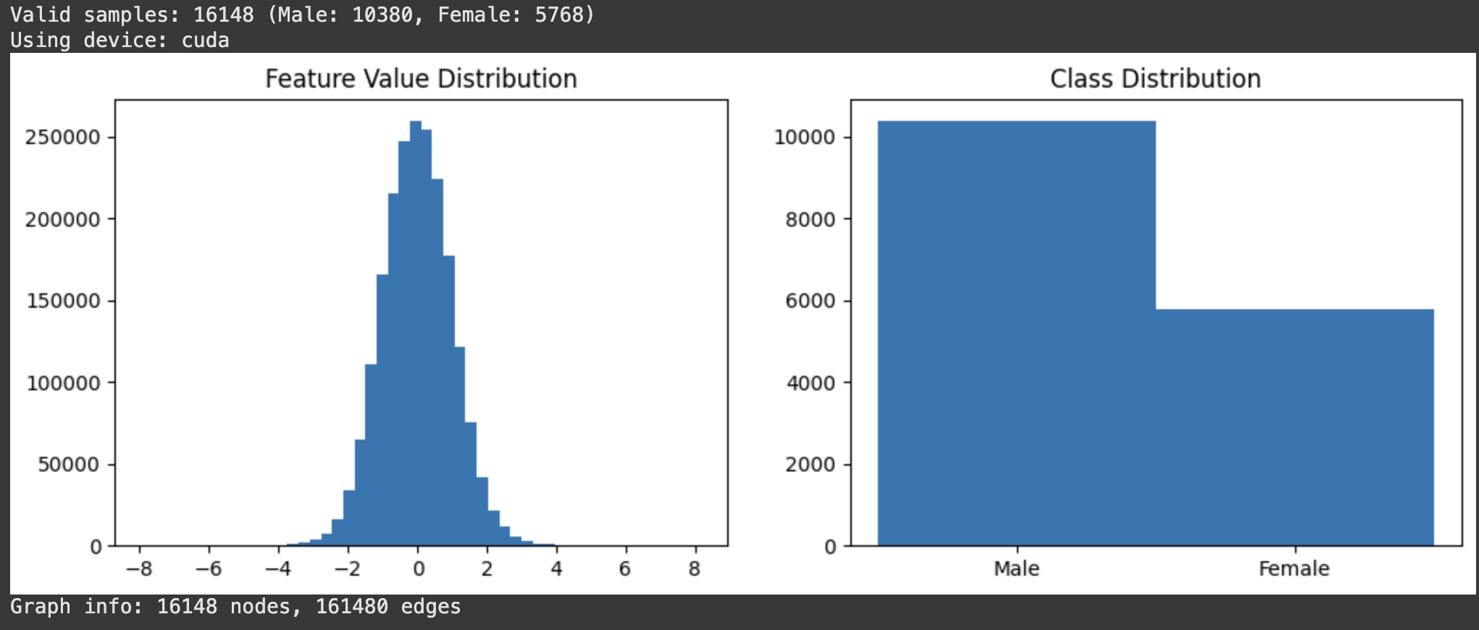
Features Analysis

Slide 17
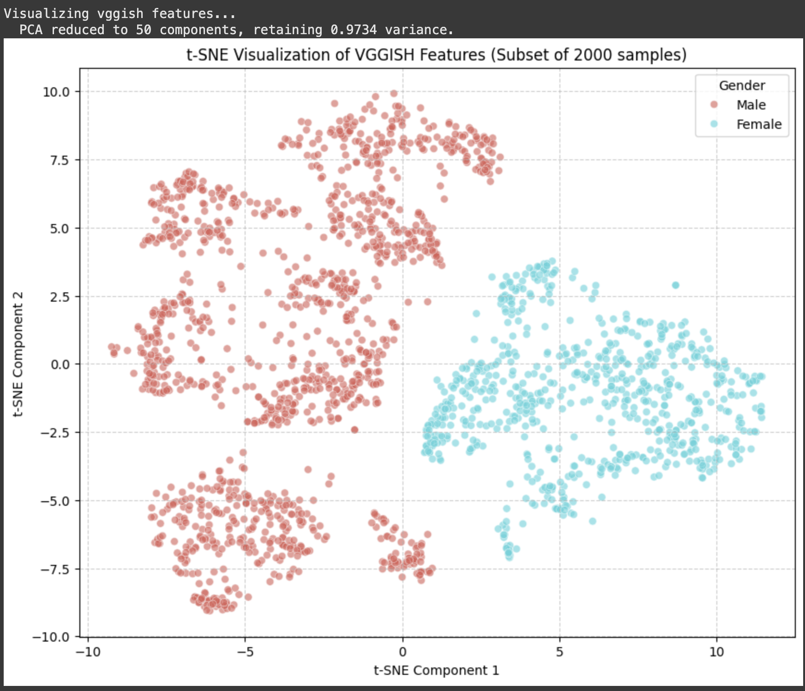
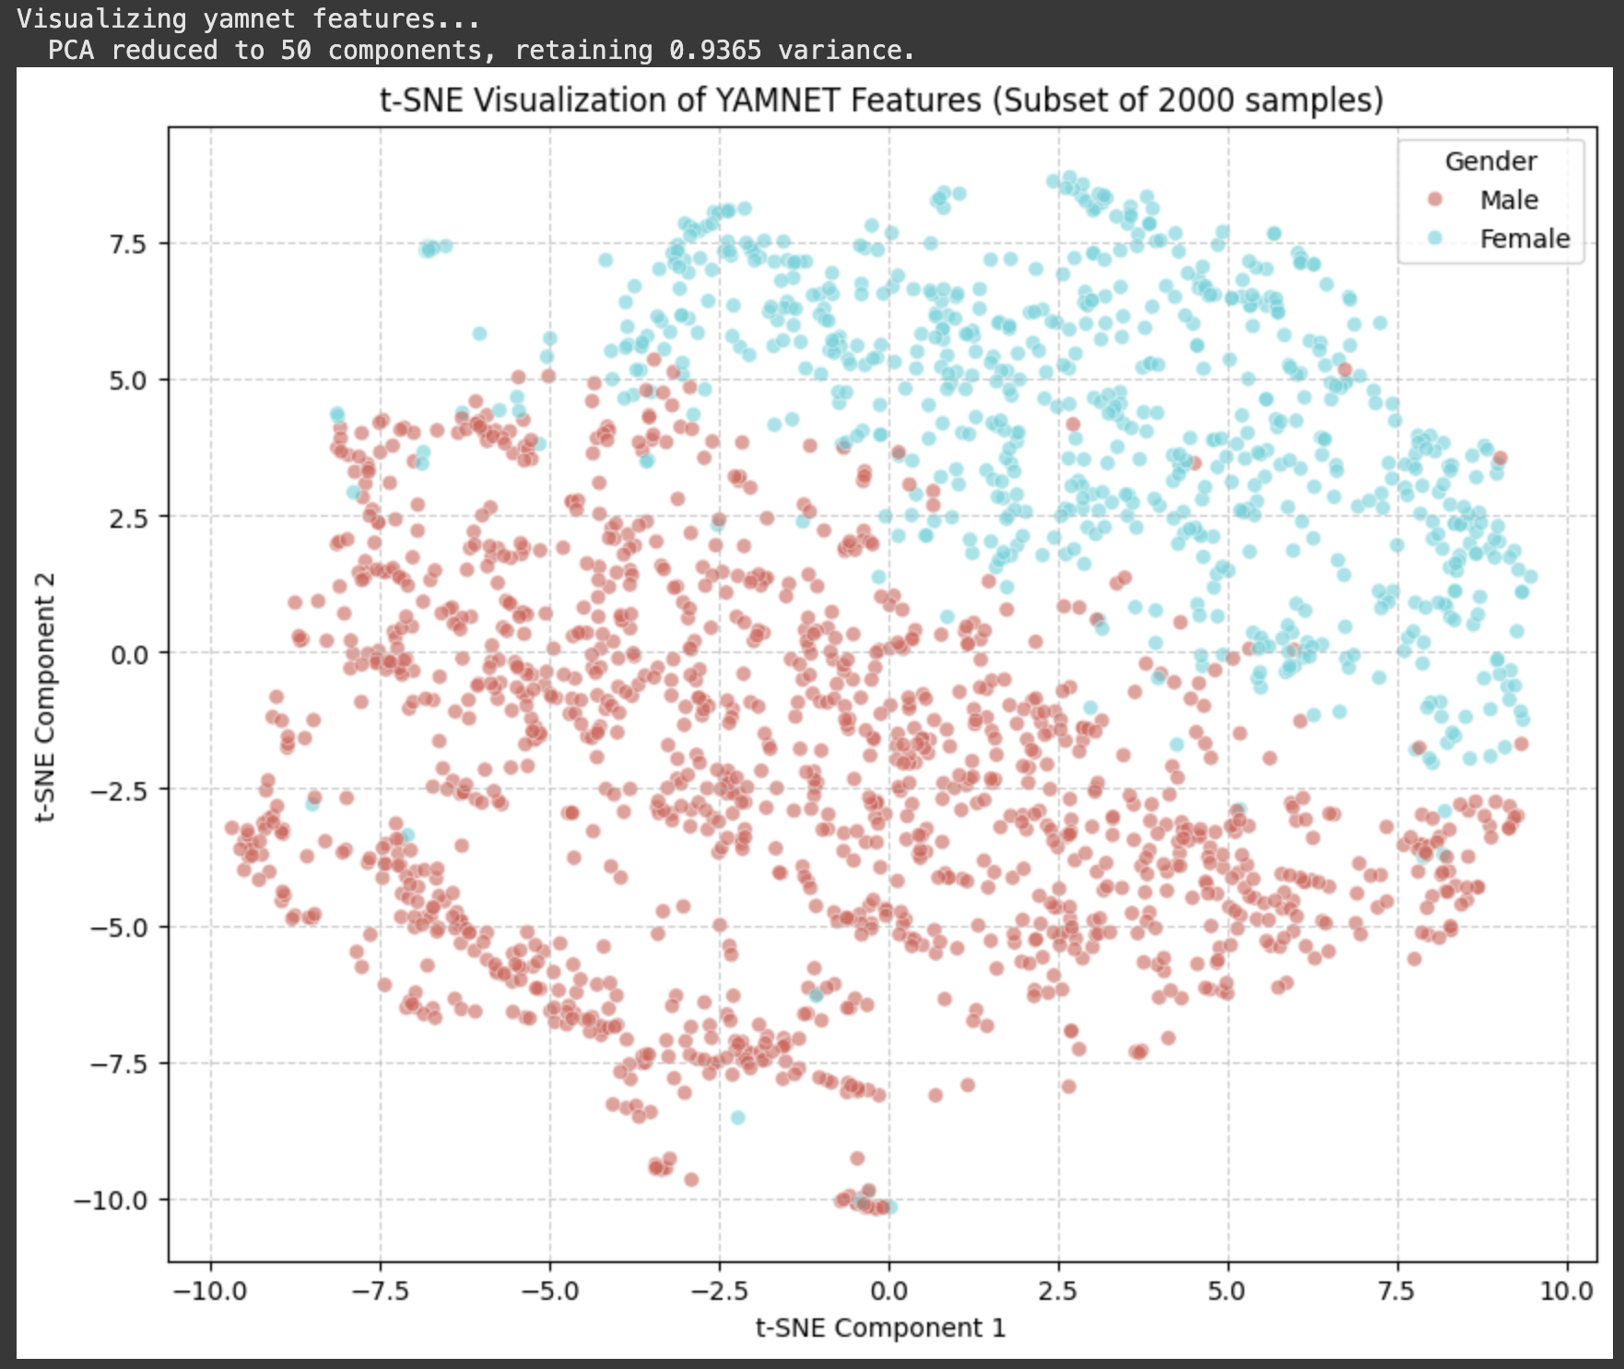
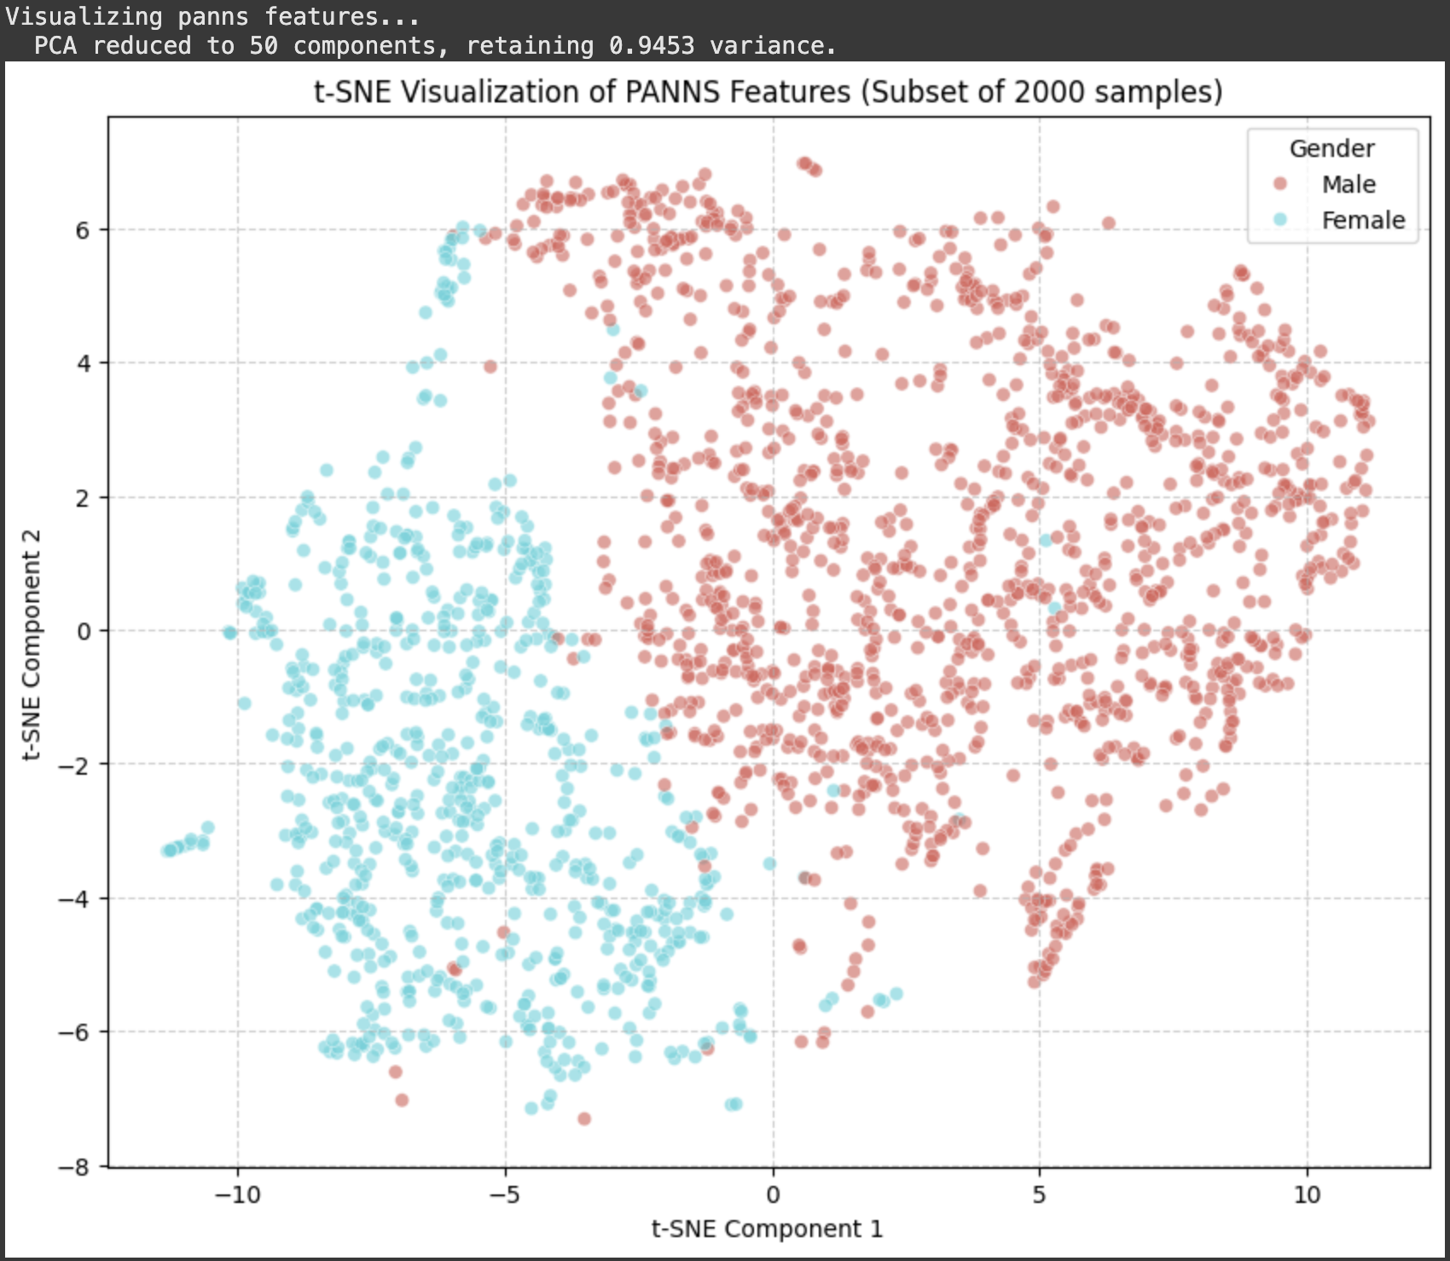
Baseline output
We used Logistic regression as our baseline model.

Slide 18
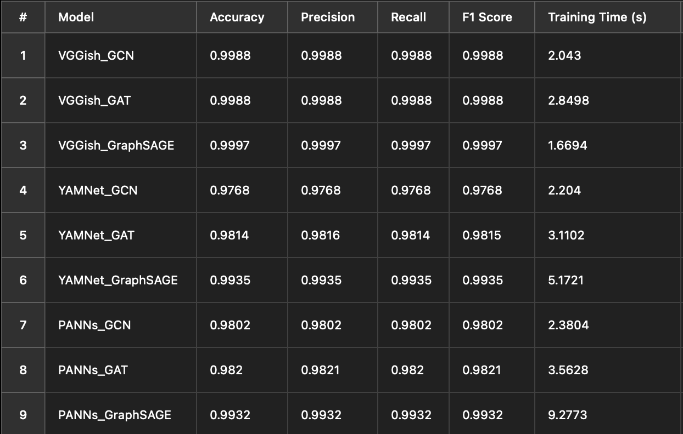
Analysis & Evaluation
GNN Audio Classification Performance

Slide 19
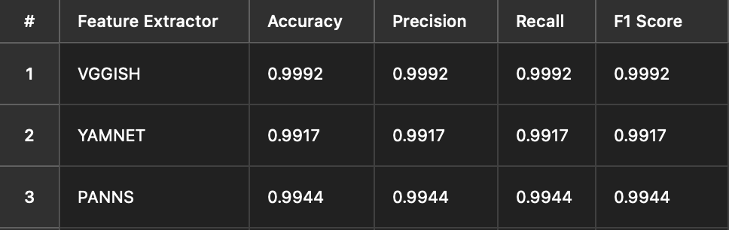
Analysis & Evaluation
Baseline Model Performance

Slide 20
Challenges
Dataset imbalance: more male than female samples
Graph construction without original paper code
Resampled to required rates (16kHz for VGGish/YAMNet, 32kHz for PANNs)
Handled audio clips with minimum duration requirements with padding/truncation.

Slide 21
Insights & Observations
Audio features do encode gender-specific traits
Graph-based methods can capture cross-sample patterns
Attention mechanism helps focus on relevant neighbors

Slide 22
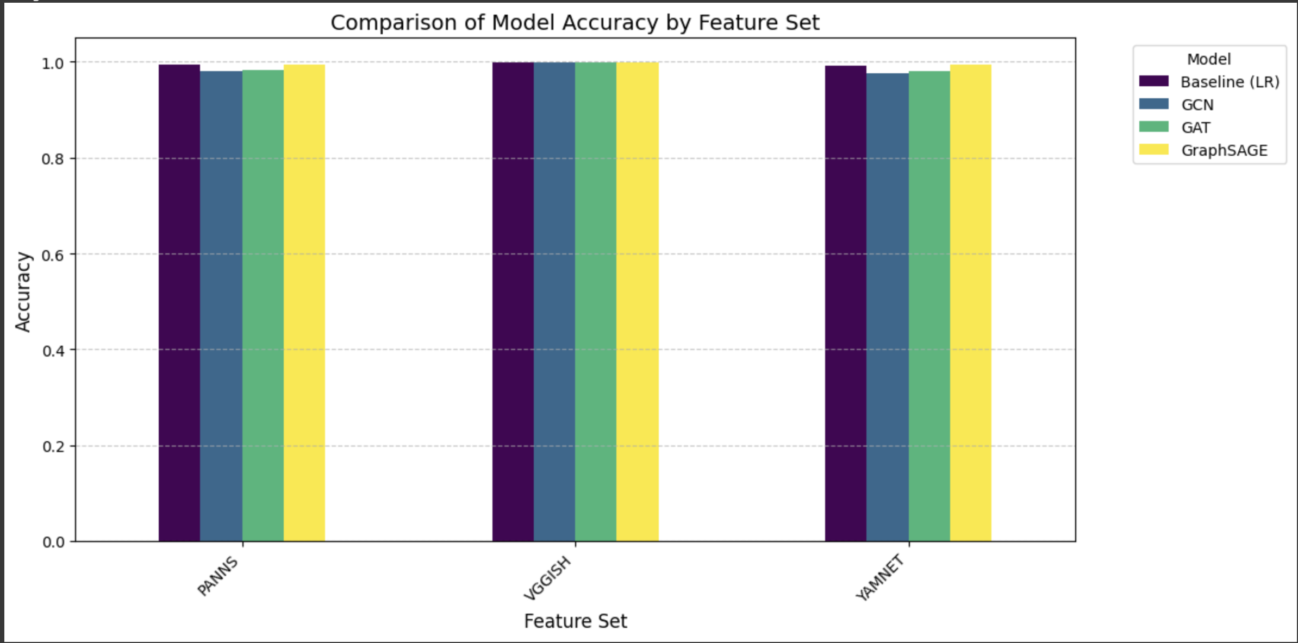
Comparison with Baseline

Slide 23
Comparison with Baseline
Feature | Baseline (LR) | GCN | GAT | GraphSAGE
PANNs | 0.9944 | 0.9802 | 0.9820 | 0.9932
VGGISH | 0.9992 | 0.9988 | 0.9988 | 0.9997
YAMNET | 0.9917 | 0.9768 | 0.9814 | 0.9935
Key Findings: Feature Extraction vs. Architecture
Feature Extraction Impact
Our results indicate that feature extraction has a greater influence on model performance than the specific GNN architecture used. Notably, VGGish provided the most meaningful and effective feature representations.
Model Architecture Comparison
Among the tested GNN models, GraphSAGE consistently outperformed the baseline on two out of three feature sets. The baseline model only slightly outperformed GraphSAGE once, with a marginal difference of 0.06%.

Slide 24
Conclusions

Slide 25
Future Work
Test multiple PTMs and compare feature embeddings
Extend to multi-class classification (e.g., age, accent, emotion)
Introduce self-supervised pretraining on audio graphs
Evaluate robustness on noisy or real-world recordings

Slide 26
Conclusions
GNNs work well for audio-based gender classification
GraphSAGE + VGGish delivered the best performance
Pretrained models (PTMs) are key to feature quality
Baseline models are strong, but GNNs offer better scalability

Slide 27
Thank you

